Slide 1

Operating Systems
Lecture 17
Syed Mansoor Sarwar

Slide 2
Agenda for Today
Review of previous lecture
Multi-level queues scheduling
Multi-level feedback queues scheduling
UNIX System V scheduling
Algorithm evaluation
Recap of lecture

Slide 3
Review of Lecture 16
Shortest-Job-First is optimal
Round-Robin scheduling
Multi-level queues scheduling

Slide 4

Multilevel Queues

Slide 5
Multilevel Feedback Queues
A process can move between the various queues; aging can be implemented this way.
Multilevel-feedback-queue scheduler defined by the following parameters:
  Number of queues
  Scheduling algorithms for each queue

Slide 6
Multilevel Feedback Queues
Method used to determine when to upgrade a process
Method used to determine when to demote a process
Method used to determine which queue a process will enter when that process needs service

Slide 7

Multilevel Feedback Queues

Slide 8
UNIX System V Scheduling Algorithm
Multilevel feedback priority queues with round robin within each queue
Quantum = 1 second
Priorities are divided into two groups/bands:
  Kernel Group
  User Group

Slide 9
UNIX System V Scheduling Algorithm
Priorities in the Kernel Group are assigned in a manner to minimize bottlenecks: processes waiting in a lower-level routine get higher priorities than those waiting at relatively higher-level routines.

Slide 10
UNIX System V Scheduling Algorithm
In decreasing order of priority, the bands are:
  Swapper
  Block I/O device control processes
  File manipulation
  Character I/O device control processes
  User processes

Slide 11
UNIX System V Scheduling Algorithm
Priorities of processes in the Kernel Group remain fixed.
Priorities of processes in the User Group are recalculated every second.
Inside the User Group, the CPU-bound processes are penalized at the expense of I/O-bound processes

Slide 12
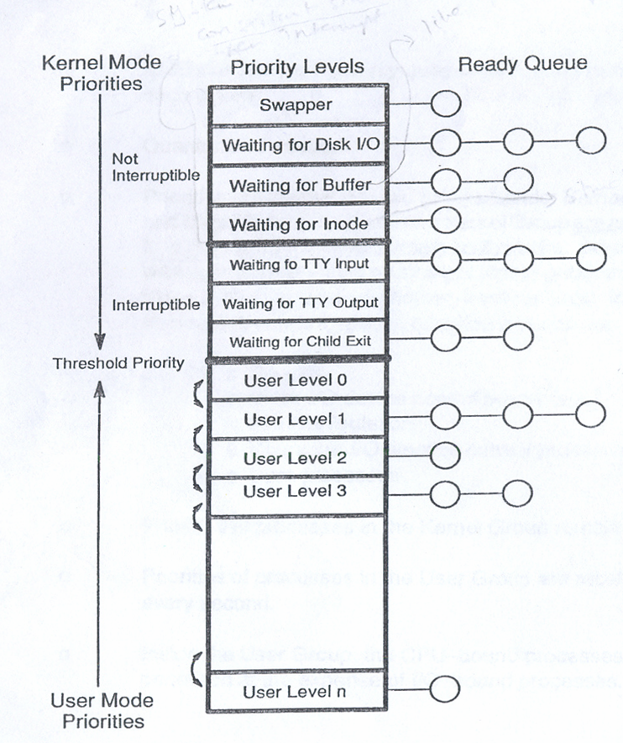
UNIX System V Scheduling Algorithm

Slide 13
UNIX System V Scheduling Algorithm
The CPU usage of each process is updated every clock tick by the clock ISR.
Every second, a decay function is applied to the CPU usage of each process in the ready queue:
    Decay (CPU Usage)=(CPU Usage)/2
Priority number of each process is recomputed every second

Slide 14
UNIX System V Scheduling Algorithm
Every second, the priority number of all those processes that are in the main memory and ready to run is updated by using the following formula:
Priority# = (Recent CPU Usage)/2 + Thr. Pri.+ nice
Threshold priority and nice values are always positive to prevent a user from migrating out of its assigned group

Slide 15
UNIX System V Example
P_{A}
P_{B}
P_{C}
CPU Count
0
1
…
60
30
30
15
7
8
…
67
33
16
CPU Count
0
0
1
…
60
30
30
15
7
8
…
67
33
CPU Count
0
0
0
1
…
60
30
30
15
7
Time
Priority
60
75
67
63
76
68
Priority
60
60
75
67
63
76
Priority
60
60
60
75
67
63
0
1
2
3
4
5

Slide 16
Recap of Lecture
Multi-level queues scheduling
Multi-level feedback queues scheduling
UNIX System V scheduling

